Slide 1




PRIYADARSHINI ENGINEERING COLLEGE
Department of Master of Computer Applications
Vaniyambadi, Tamil Nadu
Name: Surya A | Reg. No: 511924622038
MC4411 PROJECT WORK
SIGN LANGUAGE RECOGNITION SYSTEM
SUPERVISOR
HEAD OF THE DEPARTMENT
Ms.JeevaLakshmi , Assistant Professor,
Dr. Manikandan G, M.Sc., M.Phil., Ph.D.,
Master of Computer Applications, PEC.
Head of the Dept, MCA, PEC.
Anna University, Chennai

Slide 2
Contents
Abstract
Introduction
Problem Definition
Objective of the Project
Methodology
Hardware & Software Requirements
Anna University, Chennai

Slide 3
Abstract
The Sign Language Recognition System (SLRS) is an advanced computerized solution developed to bridge the communication gap between the hearing-impaired community and the general public. Traditional methods of sign interpretation are often manual, slow, and dependent on human availability.
This system automates the process of interpreting hand gestures into text and speech through real-time hand landmark detection using MediaPipe and machine learning models. It features a secure user interface for both administrators and end-users, ensuring seamless conversion of gestures into meaningful communication, thereby enhancing accessibility and operational efficiency in inclusive environments.
Anna University, Chennai

Slide 4
Introduction
In recent years, the need for inclusive technology has grown exponentially. Sign language serves as the primary mode of communication for millions of deaf and mute individuals globally. However, the lack of widespread sign language knowledge among the public creates a significant social and professional barrier.
To address this challenge, the Sign Language Recognition System (SLRS) has been developed as a real-time solution. It automates the recording, detection, and interpretation of hand gestures, converting them into visual text and audible speech in a systematic and secure manner.
Anna University, Chennai

Slide 5
Problem Definition
Communication Barriers: Most people do not understand sign language, leading to isolation.
Human Dependency: Constant reliance on professional interpreters is expensive and often unavailable.
Real-time Gaps: Manual paper-based or slow digital translations cause conversational delays.
Accessibility Issues: Public spaces (hospitals, banks, offices) lack automated tools for inclusive communication.
Anna University, Chennai

Slide 6

Objective of the Project
The main objective is to develop a reliable, high-speed platform to automate sign language interpretation. Specific objectives include:
Real-time hand landmark detection using MediaPipe.
Accurate gesture-to-text conversion via ML models.
Seamless Text-to-Speech (TTS) output for audible hearing.
User-friendly dashboard for accessible interaction.
Robust performance on standard hardware (webcams).
Anna University, Chennai

Slide 7

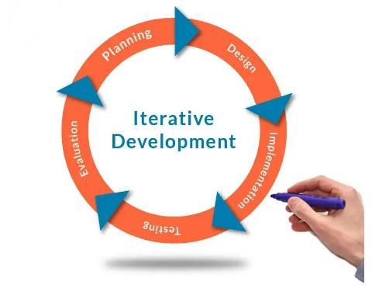
Methodology
The project follows an Iterative SDLC approach:
Step 1: Frame capture via webcam.
Step 2: Landmark mapping (21 points per hand).
Step 3: Classification via Trained Neural Network.
Step 4: Subtitle/Speech Generation.
Step 5: Feedback Loop for improved accuracy.
Anna University, Chennai

Slide 8
Hardware Requirements
Component | Specification
Processor | Intel Core i5 / AMD Ryzen 5 (2.50 GHz or higher)
RAM | 8 GB DDR4 (Minimum 4 GB for basic detection)
Hard Disk | 256 GB SSD (For faster frame extraction)
Camera | 720p HD Webcam (Integrated or External USB)
Anna University, Chennai

Slide 9
Software Requirements
Requirement Type | Technology Stack
Operating System | Windows 10 / 11
Frontend | React.js, HTML5, CSS3
Backend / Logic | Python (FastAPI / Flask)
ML Libraries | MediaPipe, OpenCV, TensorFlow / Keras
Database | MySQL (for user logs and gesture mapping)
Anna University, Chennai

Slide 10
Q & A
Thank You!
Sign Language Recognition System
Department of Master of Computer Applications
Priyadarshini Engineering College, Vaniyambadi
Anna University, Chennai

